Slide 1
Numeracy Professional Skills Test
© Dr Kinga Zaczek, Royal Holloway, University of London. Reviewer: Frances Whalley, University of Hertfordshire
All mccp resources are released under a creative commons licence, www.mathcentre.ac.uk
www.sigma-network.ac.uk Numeracy Professional Skills

Slide 2
Overview of the test
Anyone who is going into teaching must pass the numeracy and literacy skills tests
Introduced to ensure all teachers are fully competent in numeracy (and literacy), regardless of their subject
It is an additional requirement to the GCSE grade C equivalence entry requirement
Set in the context of the professional role of a teacher
To assess the use of real data and information which teachers are likely to encounter
Delivered on computers in approved test centres

Slide 3
Format of the test
28 questions
Overall pass mark is 18 out of 28 but it may vary depending on the difficulty of the questions
Lasts approximately 48 minutes - can get extra time if specific arrangements have been made
Has two sections:
12 mental arithmetic questions
16 written questions
One practice question at the beginning

Slide 4
Some practical information
You will be asked to place all your personal items in a locker
Can’t bring own paper for working
Paper/whiteboard will be given for working and will be collected before you leave the room
Multiple attempts are possible
After a certain number of free resits, charges may apply to additional attempts
Notes:
Please check the government website for up to date information about the number of possible resits and whether any charges are involved

Slide 5
Mental arithmetic questions
Section starts with an unscored practice question
12 questions each worth 1 mark
Each question is read out twice, through headphones
18 seconds to give the answer in one or more answer boxes
Returning to any questions is not possible
The use of calculator is not allowed
Make sure you make notes on the paper/whiteboard provided

Slide 6
Written questions
16 questions each worth 1 mark: 7 assess data and 9 assess arithmetic
36 minutes for the written section
No time limit for the individual questions (allow about 2 minutes per question - don’t get bogged down!)
You can go back and forward - if you find a question too difficult, leave it and come back to it later! You can flag it to remind you!
The use of an onscreen calculator is allowed

Slide 7
Test content
Mental arithmetic
addition, subtraction, multiplication and division
time
fractions, decimals and percentages
proportions involving fractions, decimals and percentages
measurement, including money, distance, area and volume
conversions
Interpret and use written data
identify trends correctly
make comparisons in order to draw conclusions
interpret information accurately
Solve written arithmetic problems
time
money
fractions, decimals and percentages
proportion and ratio
measurements (e.g. distance, area)
conversions
averages (mean, median and mode)
range
using simple formulae

Slide 8
Tip

Slide 9
5 point strategy
Read/listen to the question
Take the numbers out from the words
Decide what maths is necessary
Do the calculations
Does it seem sensible?

Slide 10
Sample questions
In the following ten slides there are:
5 mental arithmetic questions (timed at 55 seconds each) and
5 written data and arithmetic questions (with no time set up)
Notes:
Teaching staff can turn the projector off and read out the mental arithmetic questions to the students or just let the slides change themselves.

Slide 11
Mental Arithmetic
Are you ready?

Slide 12
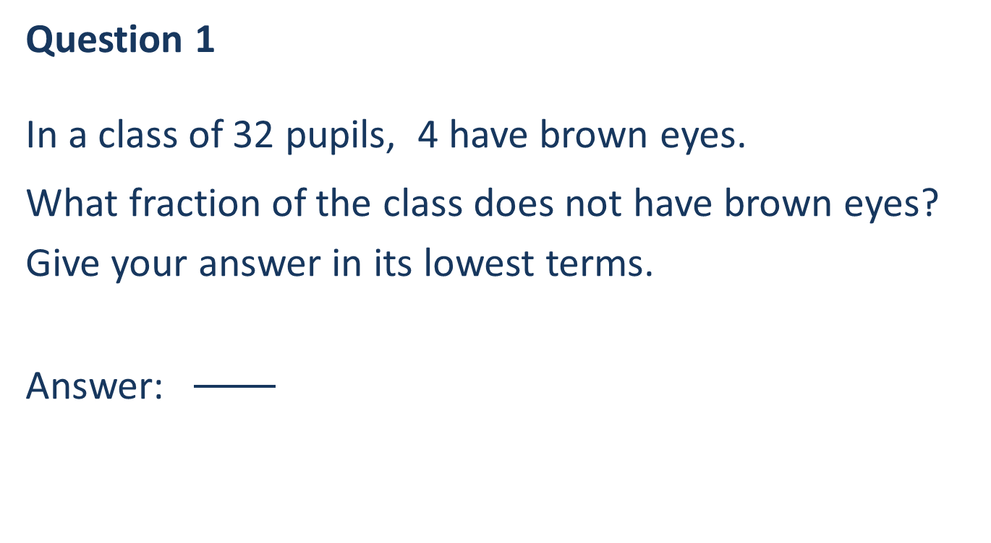
Mental Arithmetic
Question 1
In a class of 32 pupils, 4 have brown eyes.
What fraction of the class does not have brown eyes?
Give your answer in its lowest terms.
Answer:

Slide 13
Mental Arithmetic
Question 2
What is two point one five multiplied by three hundred?
Answer: __________

Slide 14
Mental Arithmetic
Question 3
Two primary schools in the same county are 120 miles away from each other.
As an approximation, 8 kilometres is equal to 5 miles.
Using this approximation, how far in kilometres are these two schools away from each other?
Answer: __________ kilometres

Slide 15
Mental Arithmetic
Question 4
Last year there were 120 pupils in Year 4. This year this number increased by five percent.
How many pupils are in Year 4 this year?
Answer: __________ pupils

Slide 16
Mental Arithmetic
Question 5
In a year group of 140 pupils, 30% came to school on scooter or by bike. 15 pupils came by bike.
How many pupils came on scooter?
Answer: __________ pupils

Slide 17

Mental Arithmetic
Answers:
Q1: $7/8$
Q2: 645
Q3: 192 km
Q4: 126 pupils
Q5: 27 pupils

Slide 18
Written Data and Arithmetic
Are you ready?
Notes:
Students to answer all five questions and then the answers can be discussed, or it can be done question by question.

Slide 19
Written Data and Arithmetic
Question 6
This bar chart shows the number
of hours pupils spend watching TV in a week.
How many pupils were surveyed?
Answer: __________ pupils

Slide 20
Written Data and Arithmetic
Question 7
This bar chart shows the number of hours pupils spend watching TV in a week. 90 pupils were surveyed.
What is the range of time spent
on watching TV?
Answer: __________ hours

Slide 21
Written Data and Arithmetic
Question 8
This bar chart shows the number of hours pupils spend watching TV in a week. 90 pupils were surveyed.
What is the modal time spent
on watching TV?
Answer: __________ hours

Slide 22
Written Data and Arithmetic
Question 9
This bar chart shows the number of hours pupils spend watching TV in a week. 90 pupils were surveyed.
What is the median time spent
on watching TV?
Answer: __________ hours

Slide 23
Written Data and Arithmetic
Question 10
This bar chart shows the number of
hours pupils spend watching TV
in a week. 90 pupils were surveyed.
What proportion of surveyed pupils
spend 10 or more hours on watching TV?
Give your answer as a decimal.
Answer: __________

Slide 24
Written Data and Arithmetic
Answers:
Q6: 90 pupils
Q7: 10 hours
Q8: 9 hours
Q9: 7.5 hours
Q10: 0.2

Slide 25
Additional Information and Support
Department for Education http://sta.education.gov.uk/
(website with detailed information about the tests and practice tests)
‘Passing the Numeracy Skills Test’ by Mark Patmore (book with many practice questions and worked out solutions)
mathcentre.ac.uk and khanacademy.org (two sample websites to help brush up numeracy skills)

Slide 26
Thank you
Any questions ???
www.sigma-network.ac.uk Numeracy Professional Skills Test

